Slide 1

JAYPEE INSTITUTE OF INFORMATION TECHNOLOGY MATHS PROJECT ON LAPLACE DIRAC DELTA FUNCTION
MADE BY :-
1. Aryaman Vishnoi (B10 - B63816) 5. Lakshay Arora (B10 - B64849)
2. Abhishek Singh (B10 - B60188) 6. Parush Sharma (B10 - B63317)
3. Himanshu Dixit (B10 - B64178) 7. Aashutosh Pradhan(B10 - B61308)
4. Mohit Garg (B9 - B63996) 8. Vatsal Agarwal (B9 - B62296)

Slide 2
CERTIFICATE
This is to certify that Aryaman Vishnoi , Lakshay Arora , Abhishek Singh , Parush Sharma , Himanshu Dixit ,Aashutosh Pradhan, Mohit Garg , Vatsal Agarwal of B-Tech, First year from CSE Branch of Batch B9-B10 have successfully created the Maths project for project based learning on the topic “DIRAC DELTA FUNCTION” under the guidance of Mrs. RICHA SHARMA Ma’am. (Maths Theory class faculty)

Slide 3
ACKNOWLEDGEMENT
Every successful venture has the blessing and the support of many behind it. It would be unjust if every such support is not revealed and thanked in person. If words were considered as a symbol of approval and token of appreciation then let the words play the heralding role expressing our gratitude.
We would like to place on record our deep sense of gratitude to Mrs. RICHA SHARMA Ma’am for giving us an opportunity to work together and her constant guidance throughout the project.
Finally, an honorable mention goes to our friends and family for their support to do us this project. Without help of the particulars mentioned above, we would have faced many difficulties while pursuing this project.

Slide 4
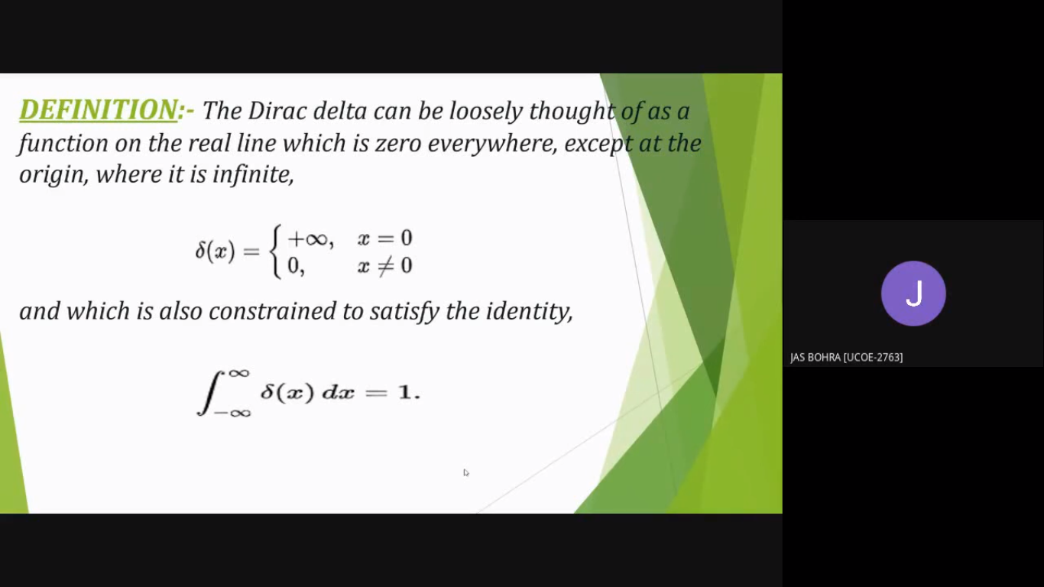

Slide 5
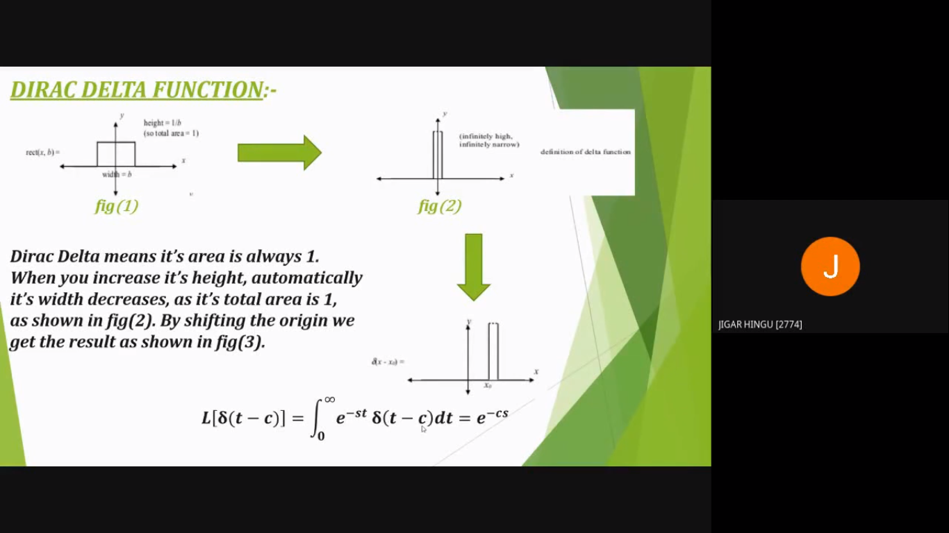

Slide 6
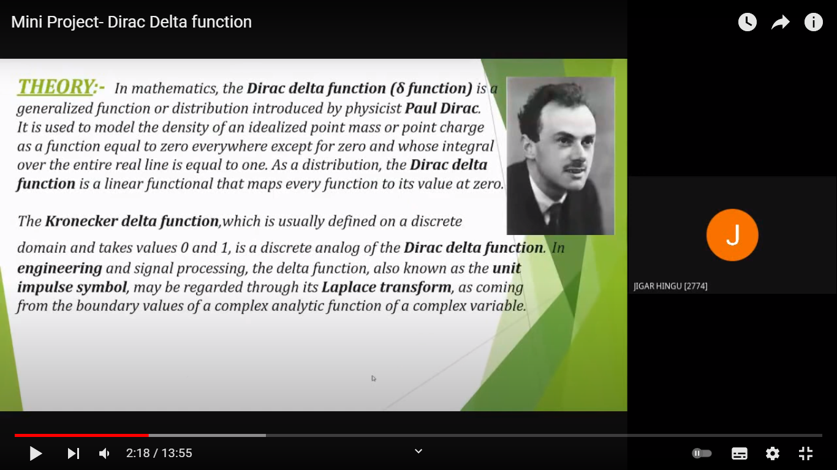

Slide 7
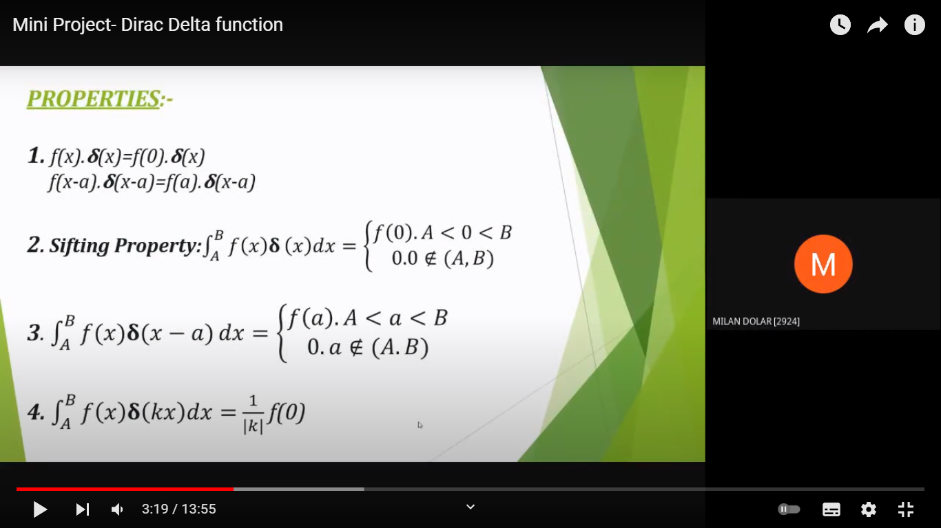

Slide 8
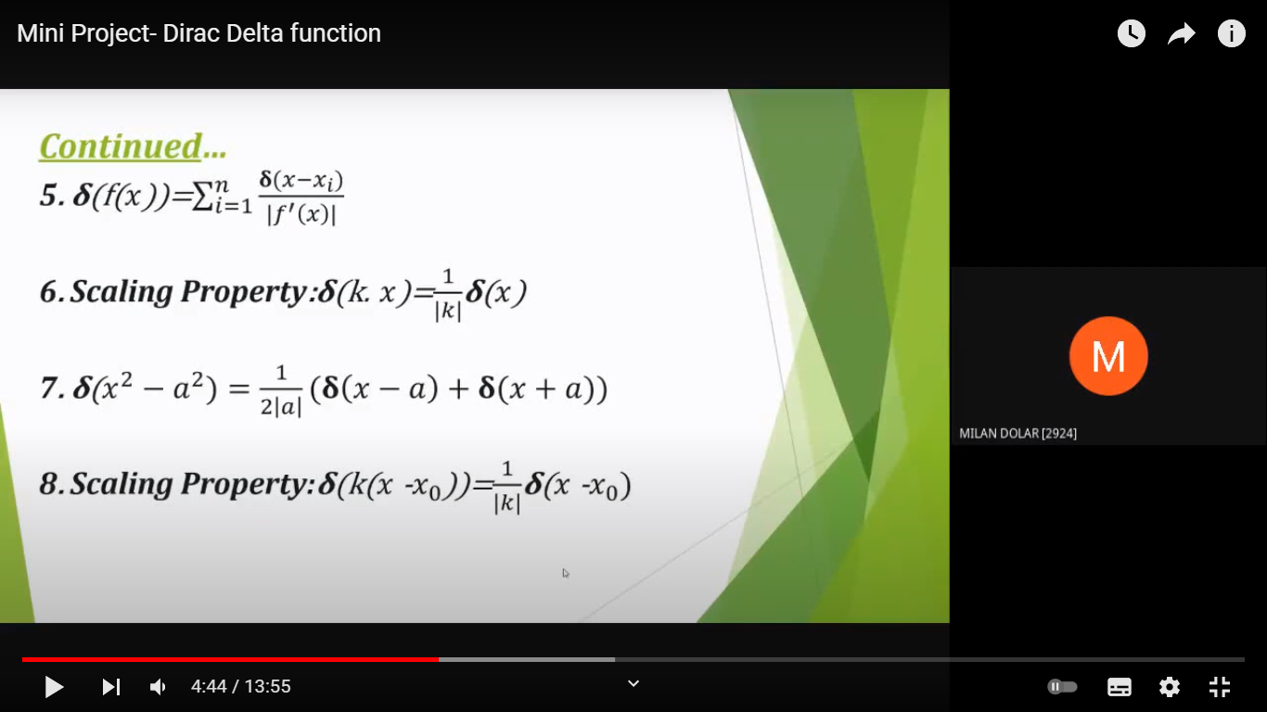

Slide 9
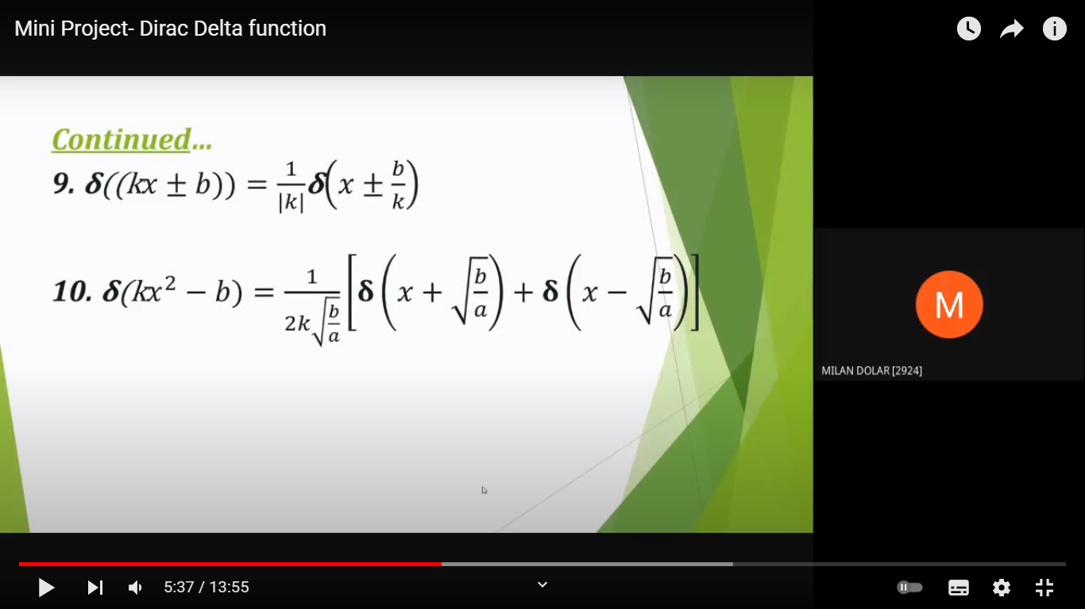

Slide 10
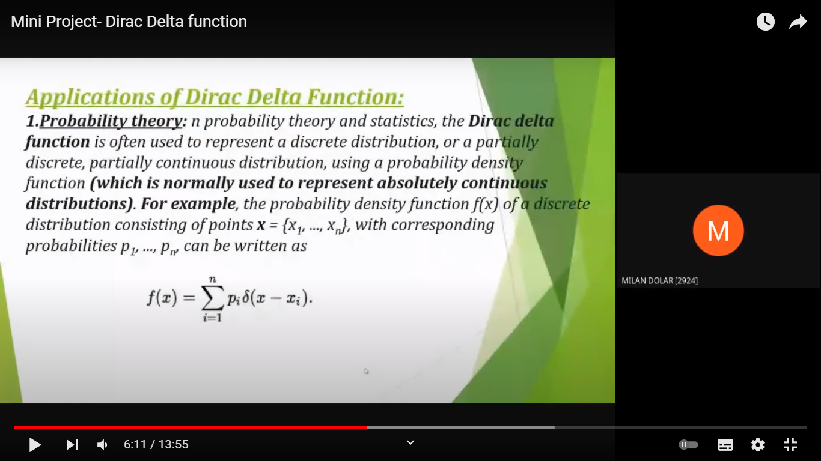

Slide 11
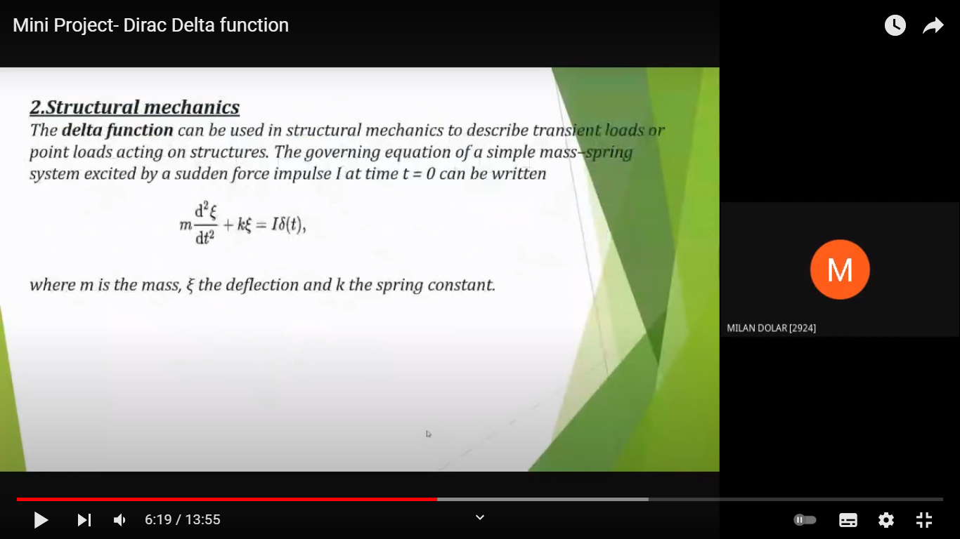

Slide 12
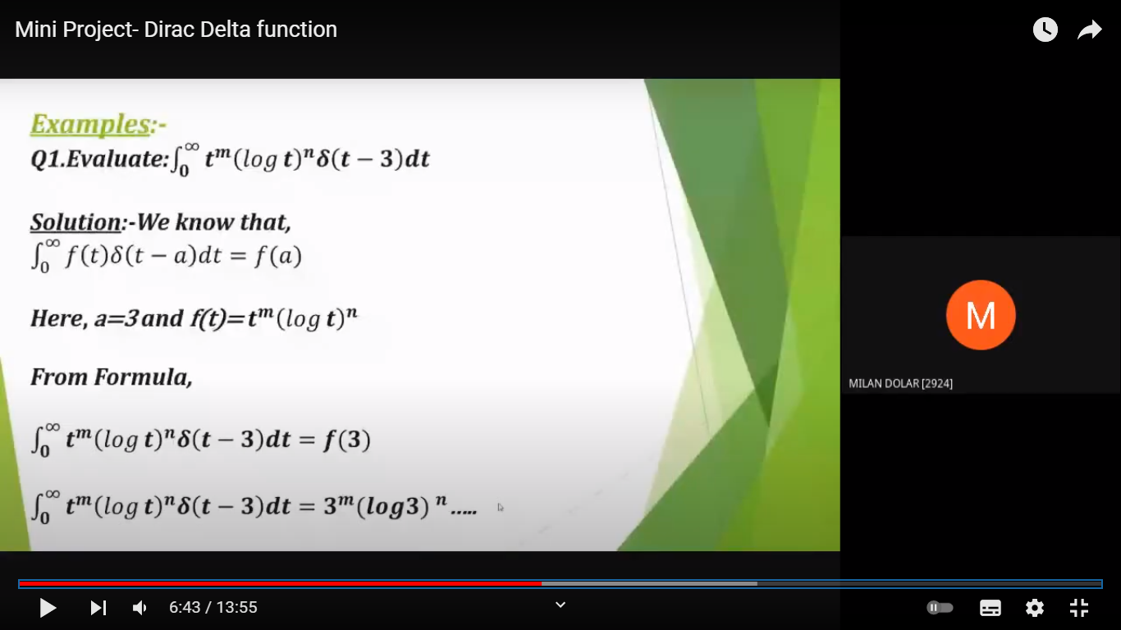

Slide 13
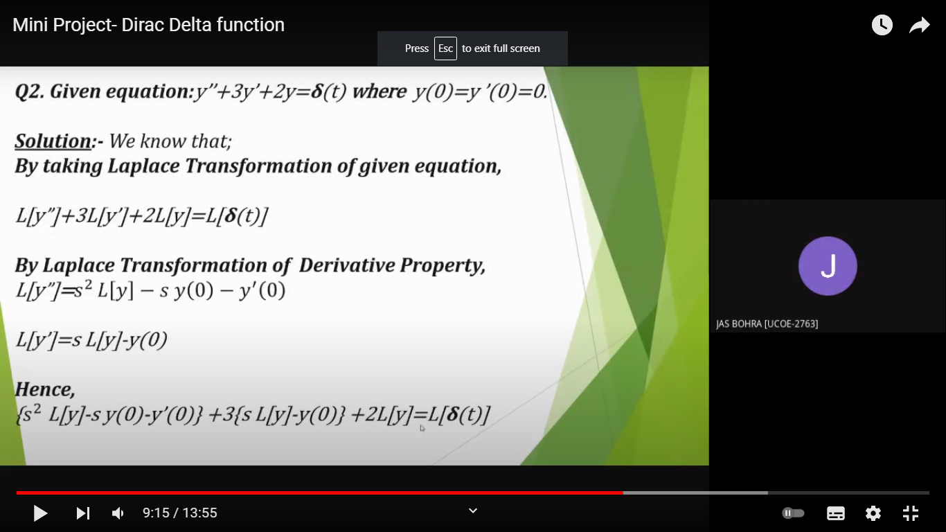

Slide 14
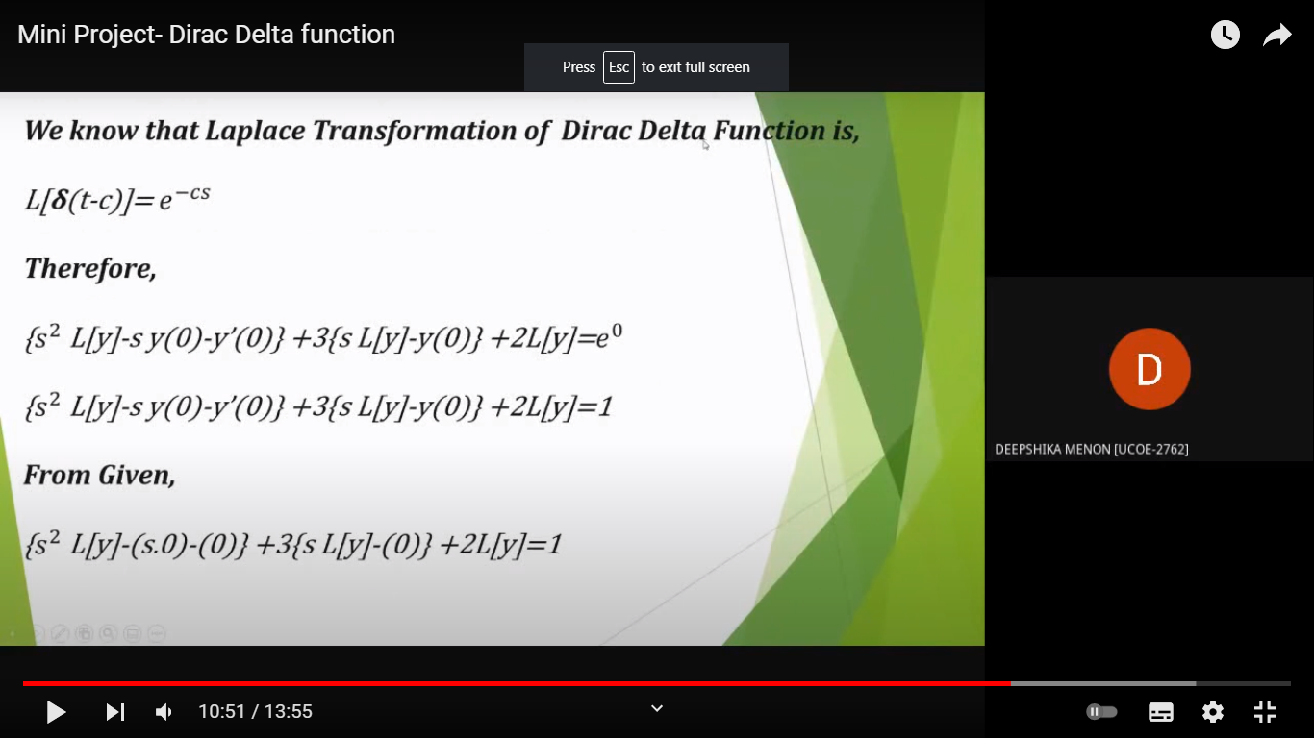

Slide 15
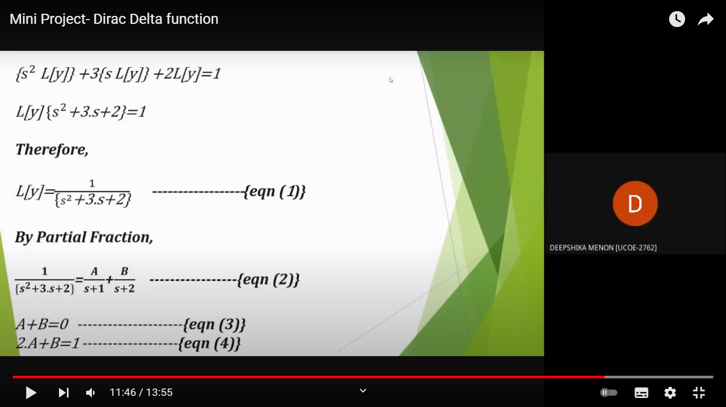

Slide 16
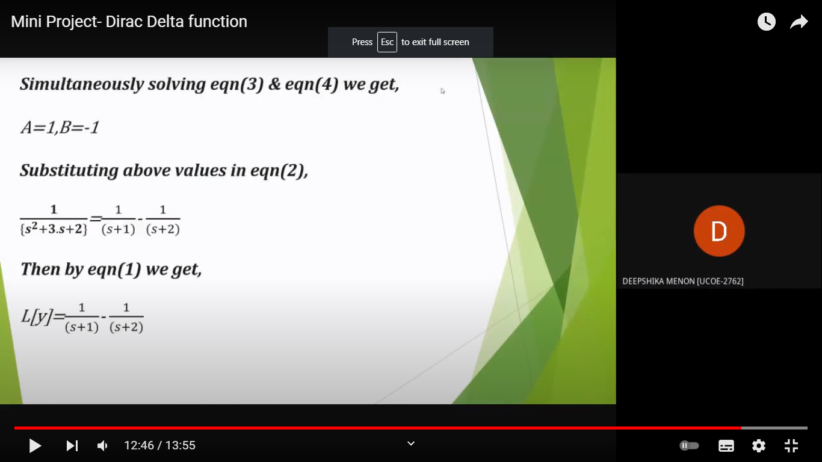

Slide 17
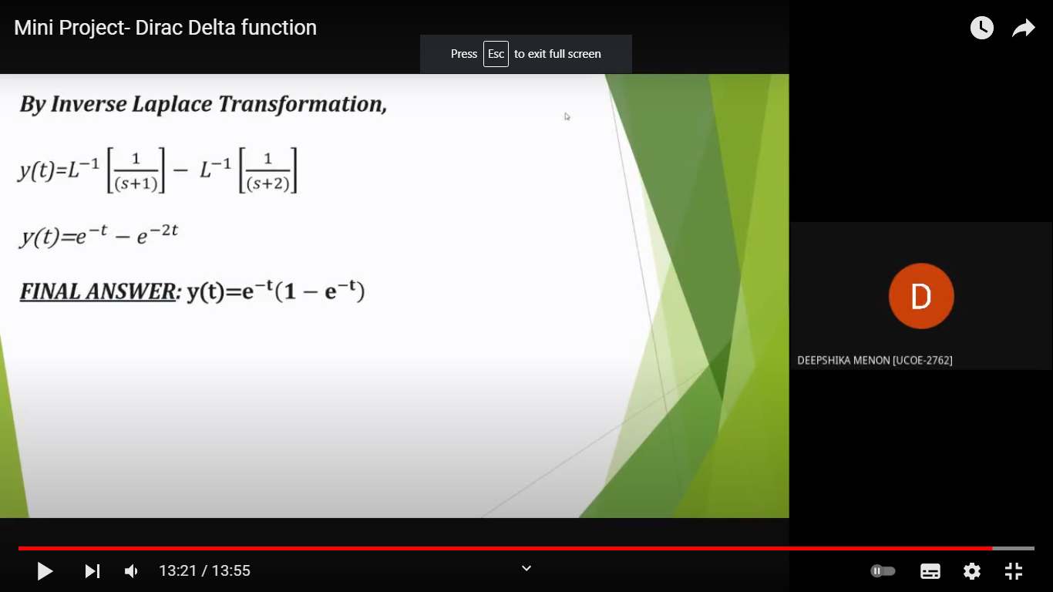

Slide 18
CONCLUSION
The Dirac delta function provides a very helpful tool in mathematical statistics.Several examples were presented in this manuscript to demonstrate its usefulness.One of its main advantages is the provision of a uniﬁed approach for the treatmentof discrete and continuous distributions. This was demonstrated in the discussionsconcerning random variables transformations. Given the generalized nature of the δ-function and its derivatives, the δ-function approach has the potential of facilitatingthe understanding and development of classical concepts in mathematical statistics

Slide 19
REFERENCES
R.K Jain and S.R.K. Iyenger, “Advanced Engineering Mathematics” fifth edition, Narosa publishing house, 2016.
https://en.wikipedia.org/wiki/Dirac_delta_function
www.sciencedirect.com/topics/engineering/dirac-delta-function
www.google.com

Slide 20
THANKING YOU

